Slide 1

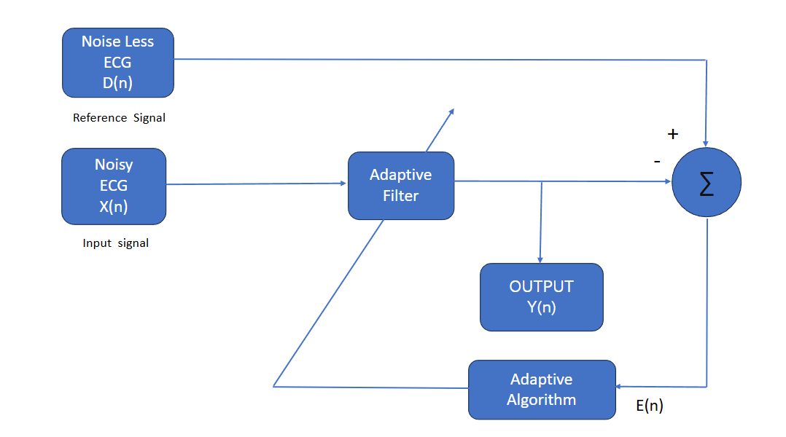
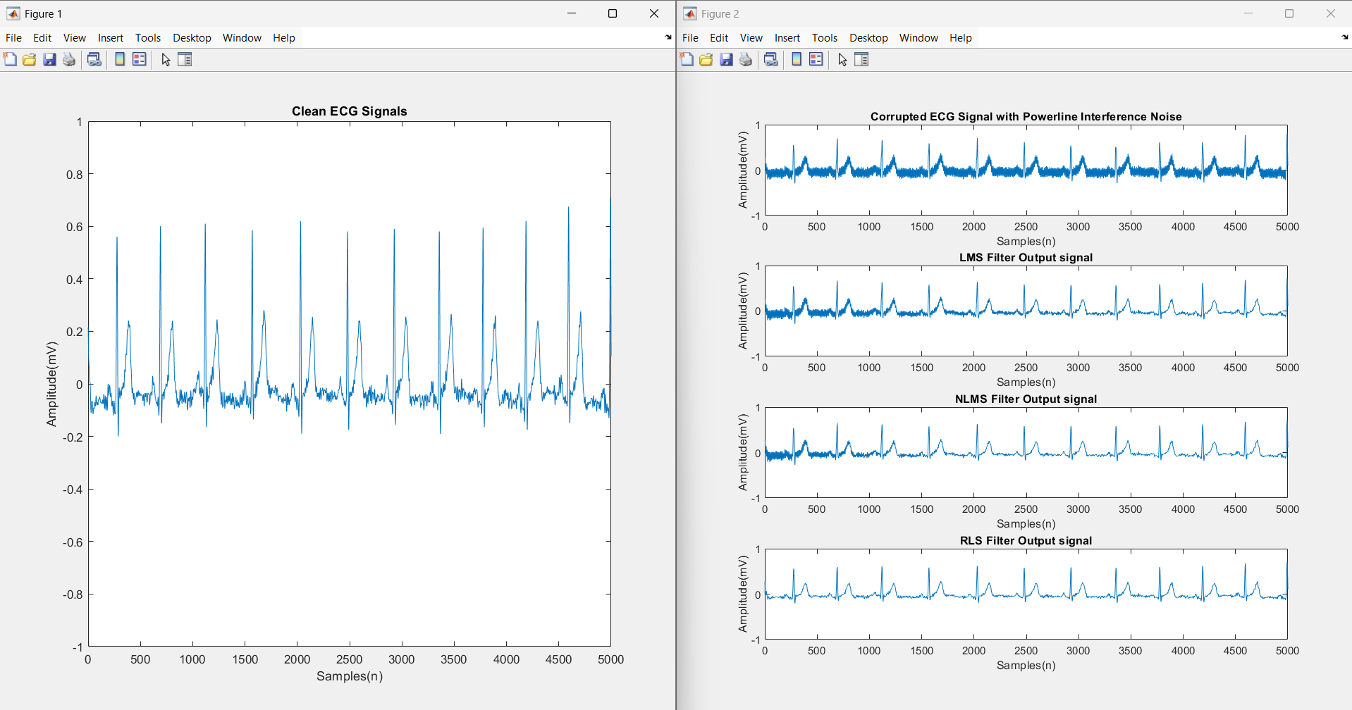
NOISE CANCELLATION IN ECG SIGNAL
Names of students: Aksheta Patel, Bhagyashree Jainapur,
Chandrashekhar Bhavi, Pruthviraj Banoshi
Under guidance of : Dr. Prabhakar Manage
Department of Electronics and Communication Engineering
Problem statement
Methodology
Results
Develop a real-time noise cancellation system for ECG signals to enhance heart rate monitoring. By removing unwanted noise and interference, the system ensures accurate readings, improving diagnostic accuracy and early detection of heart conditions.
Objectives
Minimize noise and artifacts in ECG signals.
Preserve the integrity of the ECG waveform.· Adapt dynamically to non-stationary noise.
Enable real-time noise cancellation for monitoring devices.
Enhance diagnostic accuracy in cardiac analysis.
Signal Acquisition: Capture raw ECG signals directly from the patient, including inherent noise and interference from external sources. Ensure data integrity with high-quality sensors for accurate readings.
Preprocessing: Utilize bandpass filters to isolate the ECG signal, effectively eliminating out-of-band noise. Prepare the signal for further processing while preserving key waveforms.
Adaptive Filtering: Implement algorithms like LMS or RLS to dynamically reduce noise using a reference signal. Continuously adapt to changing noise characteristics for optimal performance.
Evaluation: Measure system performance using metrics such as Signal-to-Noise Ratio (SNR), Mean Squared Error (MSE), and ECG wave clarity. Validate the effectiveness of noise cancellation techniques.
Implementation: Develop a real-time processing system for continuous noise cancellation during ECG monitoring. Ensure the system operates efficiently with minimal delay for clinical use.
Optimization details
Contributions
Noise Sources: Address powerline interference, baseline wandering, and muscle artifacts.
Preprocessing: Use band-pass filters (e.g., 0.5-50 Hz) to isolate ECG signal frequencies.
Adaptive Filtering: Apply algorithms like LMS (low complexity) or RLS (fast convergence).
Optimization: Dynamic Step Size for adaptive filters. Combine wavelet transforms for multi-resolution noise removal.
Validation: Test algorithms on standard ECG datasets
Signal Acquisition: Record raw ECG signals with noise.
Preprocessing: Apply bandpass filtering to remove out-of-band noise.
Adaptive Filtering: Use algorithms like LMS or RLS with a noise reference to adaptively reduce noise.
Implementation: Enable real-time processing for continuous noise cancellation.
Literature survey
Conclusions
Distorts ECG signals, affecting diagnosis accuracy.
Fixed notch filters may distort nearby ECG components.
LMS and RLS algorithms minimize filtering errors.
Wavelet transforms prevent artifacts during filtering.
Enhances diagnostic accuracy and ECG monitoring.
Adaptive filters effectively remove noise from ECG signals by dynamically adapting to varying conditions, improving signal quality and diagnostic accuracy. This makes them a reliable solution for clean and accurate ECG processing.
Mini Project-2024-25

